Slide 1
RK4 method and simulation results
4th order Runge Kutta numerical solver
Simulation result of the scenario where group members only want to come to their group ( by using repulsive and attractive forces)
Simulation result of the scenario where group escape together (by adding desired moving direction)
Notes:
An equation that consists of derivatives is called a differential equation
http://people.du.ac.in/~pmehta/FinalSem/Renukafinal.pdf

Slide 2

1.Runge–Kutta method
Initial value problem [1] $\dot{y}=f(t,y)$ , $y(t_{0})=y_{0}$
Given a step-size h>0, RK-4 approximates $y_{t+1}$by the present value $y_{n}$ plus the weighted average of four increments, where each increment is the product of the size of the interval, h, and slopes k estimated by the function f of the differential equation
$$y_{n+1}=y_{n}+ \frac{1}{6}(k_{1}+ 2k_{2}+ {2k}_{3}+ k_{4})$$
$$t_{n+1}=t_{n}+h$$
where
$$k_{1}=hf\left(t_{n}, y_{n}\right)$$
$$k_{2}=hf\left(t_{n}+\frac{h}{2}, y_{n}+ \frac{1}{2}k_{1}\right)$$
$$k_{3}=hf\left(t_{n} +\frac{h}{2}, y_{n}+ \frac{1}{2}k_{2}\right)$$
$$k_{4}=hf\left(t_{n}+h, y_{n}+k_{3}\right)$$
.
Notes:
Aim to approximate a y is an unknown function (vector) of time t which we would like to approximate; $\dot{y}$ is a function of time t and of y itself.

Slide 3
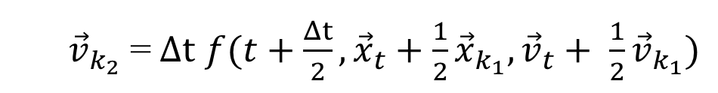
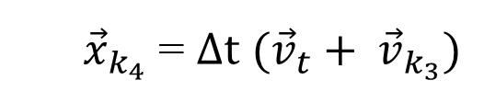
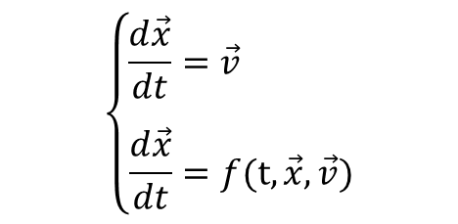
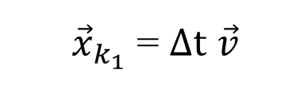
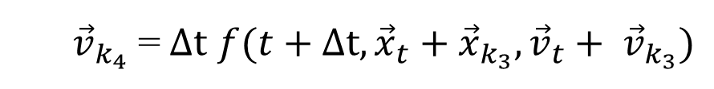
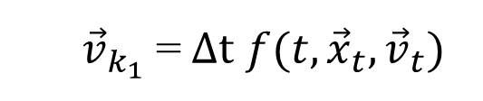
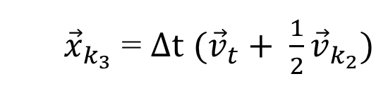
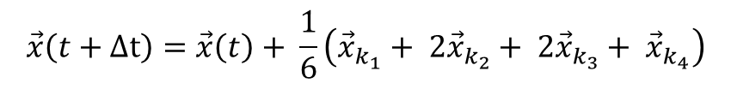
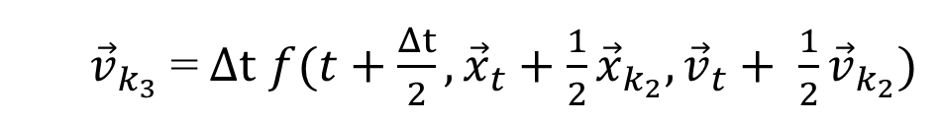
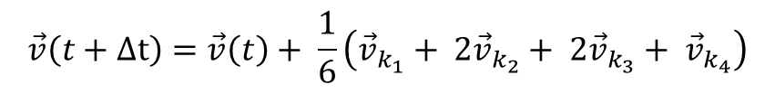
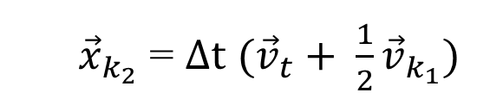
1. Runge–Kutta method to update velocity and position
Given the below system simulating the position and velocity of a group member p based on the force-based model:
$$\left\{\begin{aligned}&\frac{d\vec{x}}{dt}=\vec{v} \\ & \\ \frac{d\vec{x}}{dt}=f(t,\vec{x},\vec{v})\end{aligned}\right.$$
$$\vec{v}\left(t+Δt\right)=\vec{v}\left(t\right)+ \frac{1}{6}\left({\vec{v}}_{k_{1}}+ 2{\vec{v}}_{k_{2}}+ 2{\vec{v}}_{k_{3}}+ {\vec{v}}_{k_{4}}\right)$$
$$\vec{x}\left(t+Δt\right)=\vec{x}\left(t\right)+ \frac{1}{6}\left({\vec{x}}_{k_{1}}+ 2{\vec{x}}_{k_{2}}+ 2{\vec{x}}_{k_{3}}+ {\vec{x}}_{k_{4}}\right)$$
where
${\vec{v}}_{k_{1}}$ =$Δt$ $f(t,{\vec{x}}_{t},{\vec{v}}_{t})$
${\vec{x}}_{k_{1}}$ = $Δt$ $\vec{v}$
${\vec{v}}_{k_{2}}$ =$Δt$ $f(t+\frac{Δt}{2}, {\vec{x}}_{t}+\frac{1}{2}{\vec{x}}_{k_{1}},{\vec{v}}_{t}+ \frac{1}{2}{\vec{v}}_{k_{1}})$
${\vec{x}}_{k_{2}}$ = $Δt$ $({\vec{v}}_{t}+ \frac{1}{2}{\vec{v}}_{k_{1}})$
${\vec{v}}_{k_{3}}$ =$Δt$ $f(t+\frac{Δt}{2}, {\vec{x}}_{t}+\frac{1}{2}{\vec{x}}_{k_{2}},{\vec{v}}_{t}+ \frac{1}{2}{\vec{v}}_{k_{2}})$
${\vec{x}}_{k_{3}}$ = $Δt$ $({\vec{v}}_{t}+ \frac{1}{2}{\vec{v}}_{k_{2}})$
${\vec{v}}_{k_{4}}$ =$Δt$ $f(t+Δt, {\vec{x}}_{t}+{\vec{x}}_{k_{3}},{\vec{v}}_{t}+ {\vec{v}}_{k_{3}})$
${\vec{x}}_{k_{4}}$ = $Δt$ $({\vec{v}}_{t}+ {\vec{v}}_{k_{3}})$
Each above increment is calculated simultaneously for all group members to make sure that members are calculated at proper positions and velocities at times t, and $t+\frac{Δt}{2}$, and $t+Δt$.
Notes:
And other reference,
http://rosettacode.org/wiki/Runge-Kutta_method#C
https://people.sc.fsu.edu/~jburkardt/cpp_src/rk4/rk4.cpp
http://deepanshubhatti.blogspot.com.au/2013/10/to-solve-differential-equation-by_6120.html
http://www.maths.tcd.ie/~ryan/TeachingArchive/161/teaching/harm_osc_rk.c.html

Slide 4
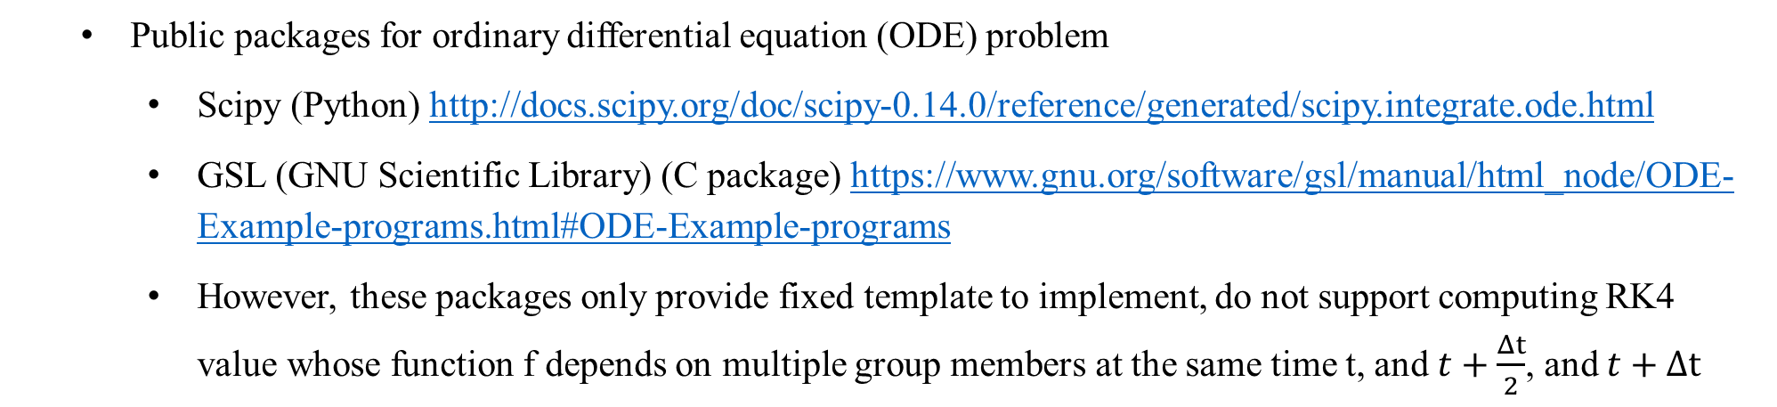
1. RK Reference
Reference for RK4 solver for two simultaneous equations of N-body Mass Gravitational Problem
http://web.mit.edu/pkrein/Public/Final%20Paper%20UW324.pdf
http://www.engr.colostate.edu/~thompson/hPage/CourseMat/Tutorials/CompMethods/Rungekutta.pdf
http://physics.bu.edu/~py502/slides/l07.pdf
Public packages for ordinary differential equation (ODE) problem
Scipy (Python) http://docs.scipy.org/doc/scipy-0.14.0/reference/generated/scipy.integrate.ode.html
GSL (GNU Scientific Library) (C package) https://www.gnu.org/software/gsl/manual/html_node/ODE-Example-programs.html#ODE-Example-programs
However, these packages only provide fixed template to implement, do not support computing RK4 value whose function f depends on multiple group members at the same time t, and $t+\frac{Δt}{2}$, and $t+Δt$
Implement RK4 at C level and embed the created model in Python simulation to boost performance

Slide 5
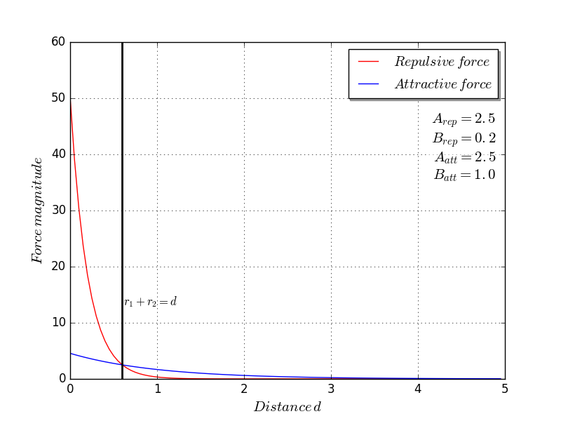


2. Simulation result of the model using repulsive and attractive forces
$\vec{f_{p}}\left(t\right)$ = $\sum_{q(≠p)}{{\vec{f}}_{pq}^{rep}\left(t\right)+ \sum_{q(≠p)}{{\vec{f}}_{pq}^{att}\left(t\right)}}$
$${\vec{f}}_{pq}^{rep}\left(t\right)=A_{rep}e^{\left(\frac{(R_{p}+R_{q})−d_{pq}}{B_{rep}}\right)}\vec{u_{qp}}$$
Repulsive force created by pedestrian q on pedestrian p
$${\vec{f}}_{pq}^{att}\left(t\right)=A_{att}e^{\left(\frac{(R_{p}+R_{q})−d_{pq}}{B_{att}}\right)}\vec{u_{pq}}$$
Attractive force represents that p moves close to pedestrian q
$B_{rep}<B_{att}$ to make group members come close to each other
Notes:
As mentioned by Helbing, Vicsek []

Slide 6
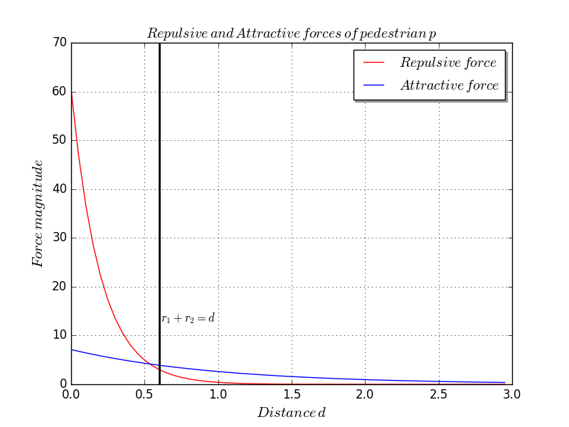
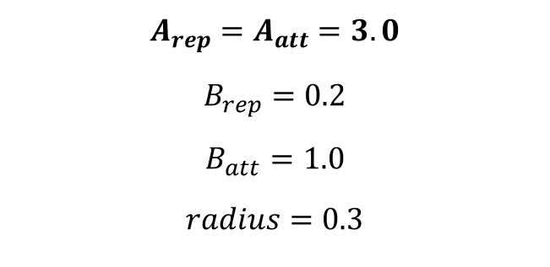
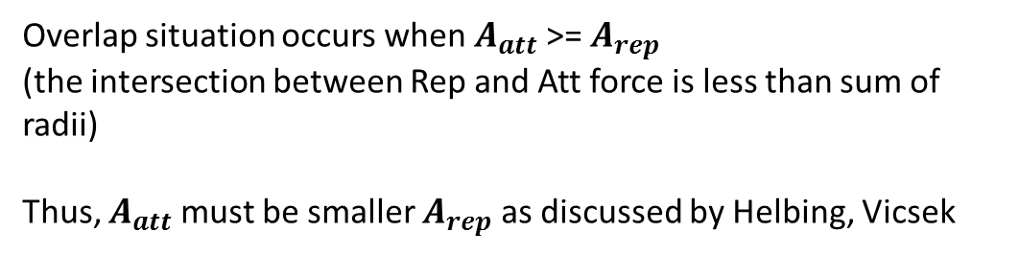
2. Simulation result of the model using repulsive and attractive forces
p
q
k
Overlap situation
Given a simulation of three pedestrians on 1-D at time t where
pedestrians q and k are collide
pedestrians p, q, k share the same parameter values:
d
$$A_{rep}=A_{att}=3.0$$
$$B_{rep}=0.2$$
$$B_{att}=1.0$$
$$radius=0.3$$
Overlap situation occurs when $A_{att}$ >= $A_{rep}$
(the intersection between Rep and Att force is less than sum of radii)
Thus, $A_{att}$ must be smaller $A_{rep}$ as discussed by Helbing, Vicsek
Notes:
As mentioned by Helbing, Vicsek []
Step 1. As Helbing, Molnar, .. We should set A_att smaller than in setting distribution parameter to simulate realistic.

Slide 7
2. Simulation result of two group members
Why do two pedestrian move away when they collide and then come close to each other again?
p
q
At time t, suppose that vtp = vtq = 0.2
p
q
p
q
Preserve their original velocity

Slide 8
2. Simulation result of the model using repulsive and attractive forces
With $Δt$ = 0.005, N = 100 , automatically split into smaller group as the group theorem from previous paper

Slide 9
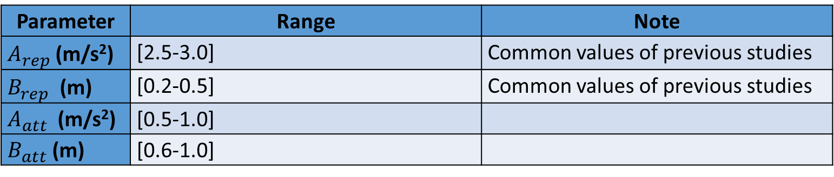
2. Simulation result of the model using repulsive and attractive forces
Parameter | Range | Note
$A_{rep}$ (m/s²) | [2.5-3.0] | Common values of previous studies
$B_{rep}$ (m) | [0.2-0.5] | Common values of previous studies
$A_{att}$ (m/s²) | [0.5-1.0]
$B_{att}$ (m) | [0.6-1.0]
The group of N= 5 pedestrians is being simulated on Monash Campus Cluster to obtain $A_{rep}$/$A_{att}$, $B_{rep}$/$B_{att}$ and Sobol indices of parameters
Notes:
Given commonly and calibrated A_rep, B_rep of previous Helbing’s study, A_att, B_att is selected so that thay are not overlap.

Slide 10
3. Simulation result of the model using both desired, repulsive, and attractive forces

